Slide 1
TB Around the World and the new Canadian TB Standards 7th Ed.
Dominik Mertz, MD, MSc
Medical Director Infection Prevention and Control,
Hamilton Health Sciences
Assistant Professor, Department of Medicine, and Clinical Epidemiology and Biostatistics, McMaster University
18th Annual Infection Prevention and Control Education Day May 8, 2014

Slide 2
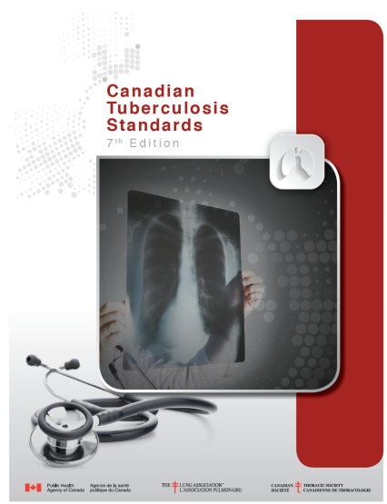
Objectives
Epidemiology of TB around the world
Highlights of the Canadian TB Standards
Available at: http://www.respiratoryguidelines.ca/tb-standards-2013

Slide 3
Challenging task…
TB around the world
In 2012:
~8.6 Mio developed Tb
~1.3 Mio died of Tb
3.6% of new and 20% of previously treated cases estimated to be MDR-TB
World Health Organization. WHO Report 2013 – Global Tuberculosis Control.
Geneva: World Health Organization, 2013. WHO/HTM/TB/2013.11

Slide 4
Challenging task…
TB Standards 7th Edition
16 Chapters
5 Appendices
467 pages in total
in 40 minutes… 5.1 seconds per page
Available at: http://www.respiratoryguidelines.ca/tb-standards-2013

Slide 5
Objectives
Chapter 1 of Canadian TB Standards
Epidemiology of TB around the world, in Canada, and Ontario
Highlights of the Canadian TB Standards
Available at: http://www.respiratoryguidelines.ca/tb-standards-2013

Slide 6
Objectives
Chapter 1 of Canadian TB Standards
Epidemiology of TB around the world, in Canada, and Ontario
Highlights of the Canadian TB Standards relevant for infection prevention in the healthcare setting in Ontario
Available at: http://www.respiratoryguidelines.ca/tb-standards-2013

Slide 7
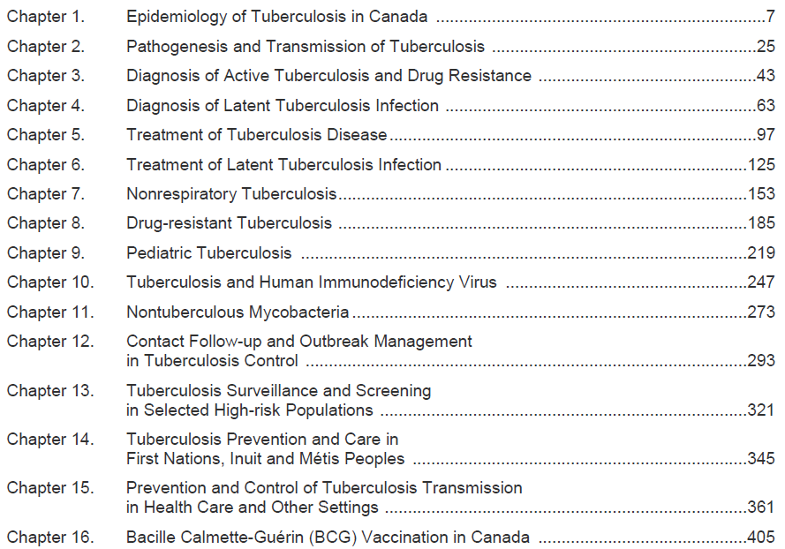
Canadian TB Standards 7th Edition
x
x
x
x
x
x
x
x
x
Available at: http://www.respiratoryguidelines.ca/tb-standards-2013

Slide 8
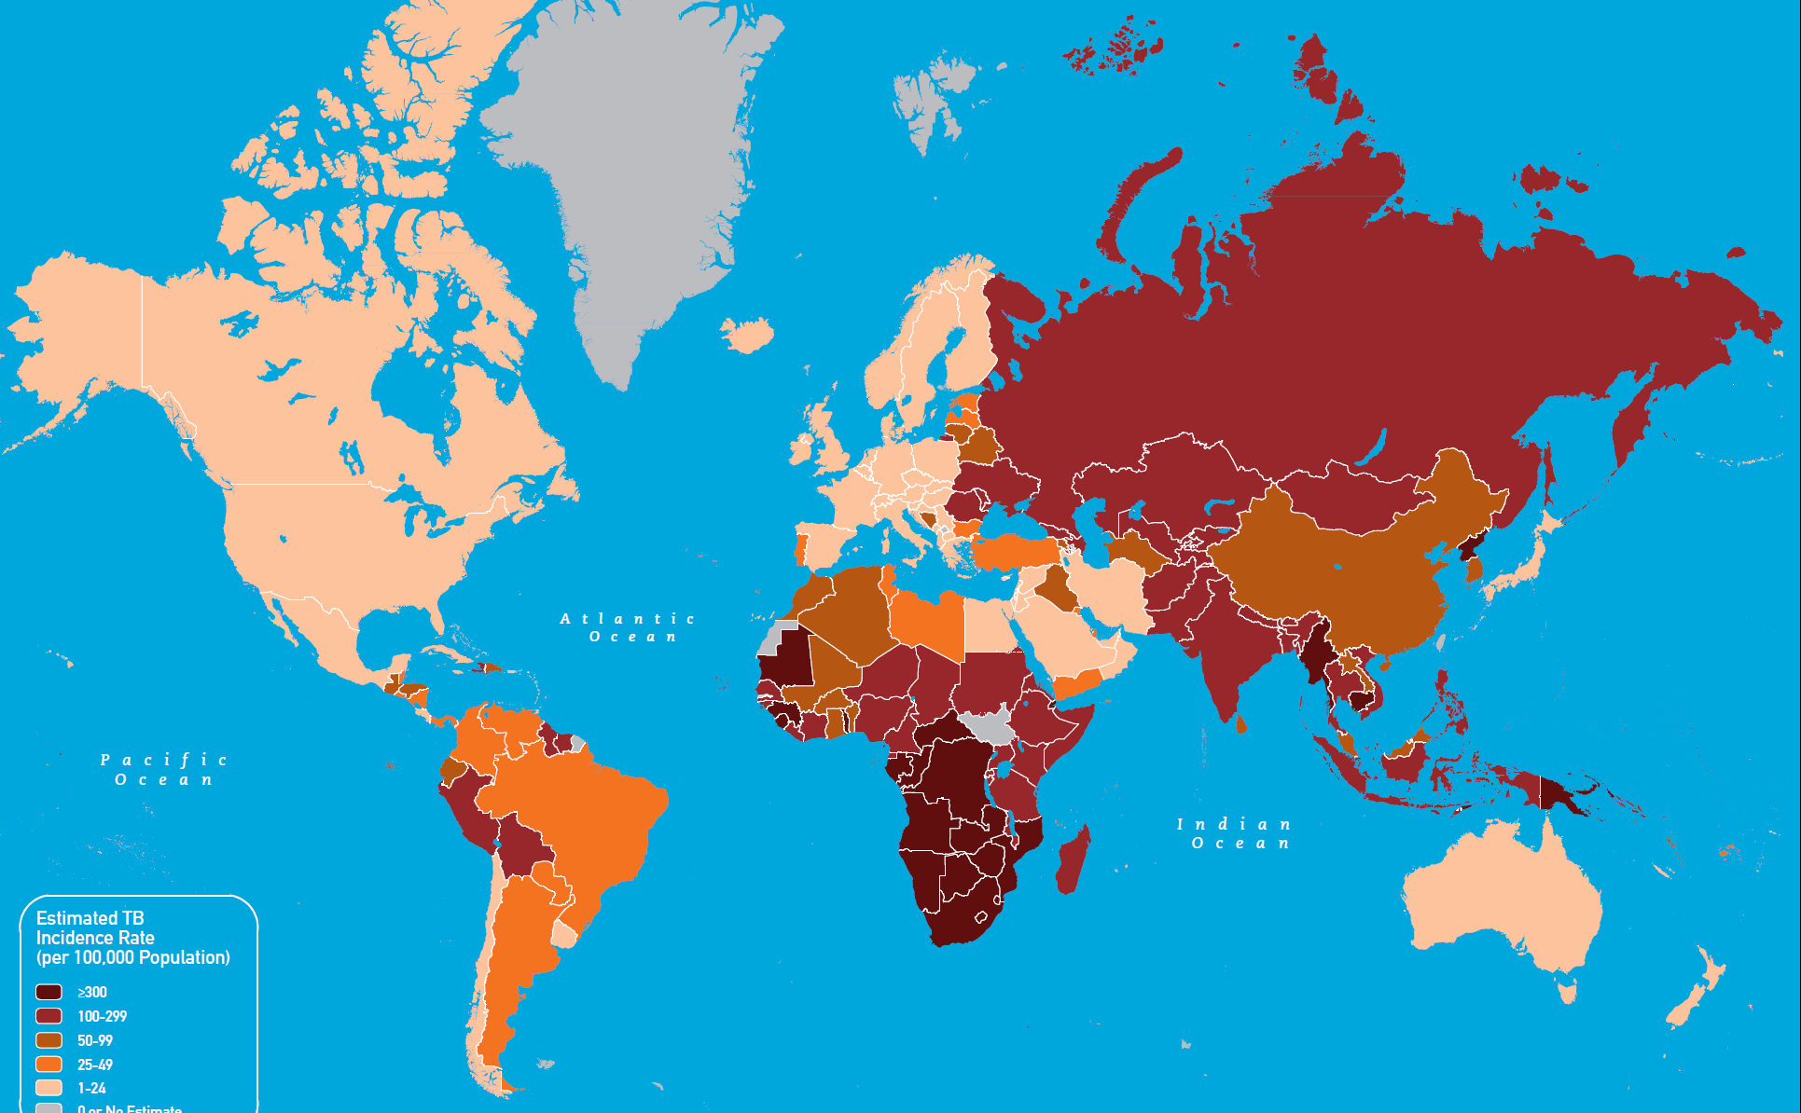
TB around the world
Available at: http://wwwnc.cdc.gov/travel/content/yellowbook/2014/map_3-13.pdf

Slide 9
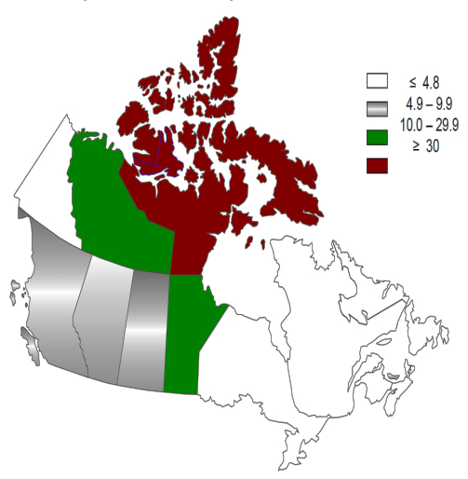
TB around the world
From: Public Health Agency of Canada, Tuberculosis in Canada: 2002-2012

Slide 10
TB around the world
Ontario: Lowest rates but 40% of Canadian cases
From: Public Health Agency of Canada, Tuberculosis in Canada: 2002-2012

Slide 11
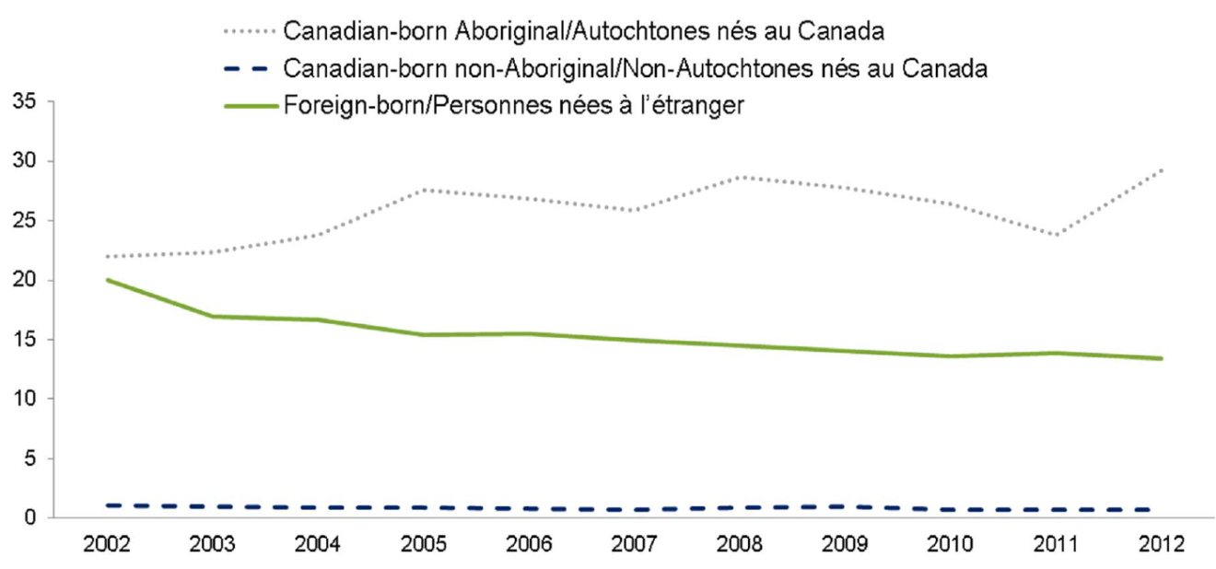
TB around the world
From: Public Health Agency of Canada, Tuberculosis in Canada: 2002-2012

Slide 12
TB around the world
Highest rates in Canada/100,000 in 2012:
Inuit: 262.2
First nations: 23.7
Africa, high HIV prevalence: 38.9
South East Asia: 30.0
Western Pacific: 22.7
Africa, low HIV prevalence: 20.8
From: Public Health Agency of Canada, Tuberculosis in Canada: 2002-2012

Slide 13
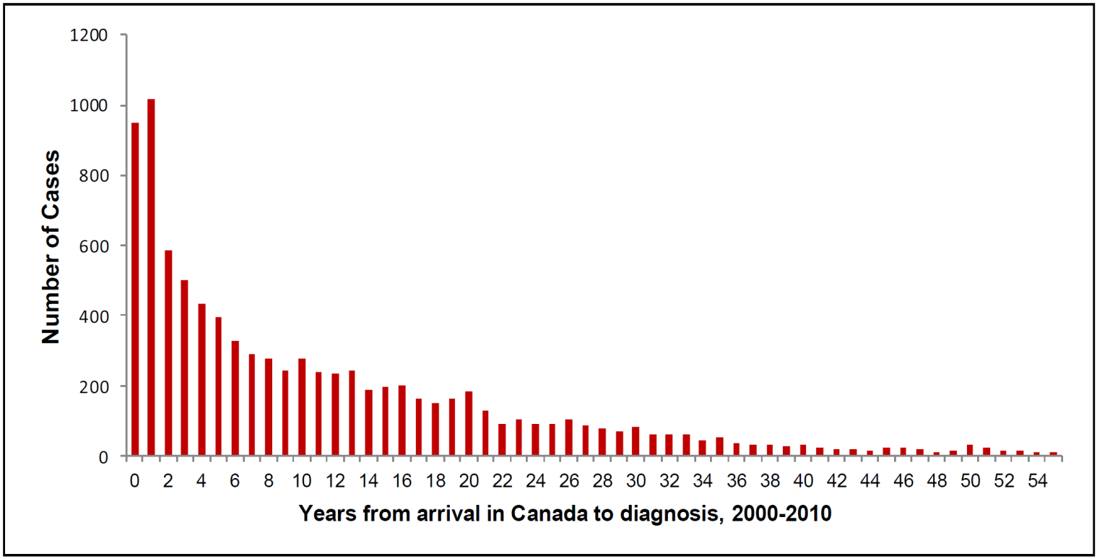
TB around the world
Highest rates in Canada/100,000 in 2012:
Inuit: 262.2
First nations: 23.7
Africa, high HIV prevalence: 38.9
South East Asia: 30.0
Western Pacific: 22.7
Africa, low HIV prevalence: 20.8
From: Canadian TB Standards 7th Edition

Slide 14
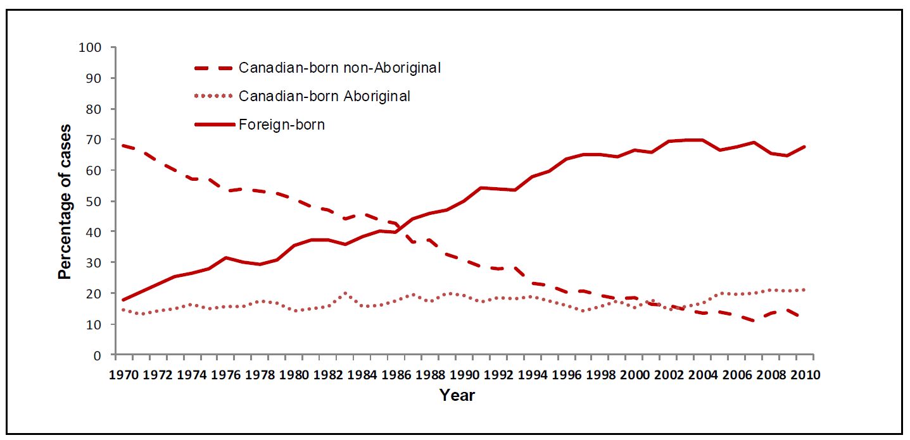
TB around the world
From: Canadian TB Standards 7th Edition

Slide 15
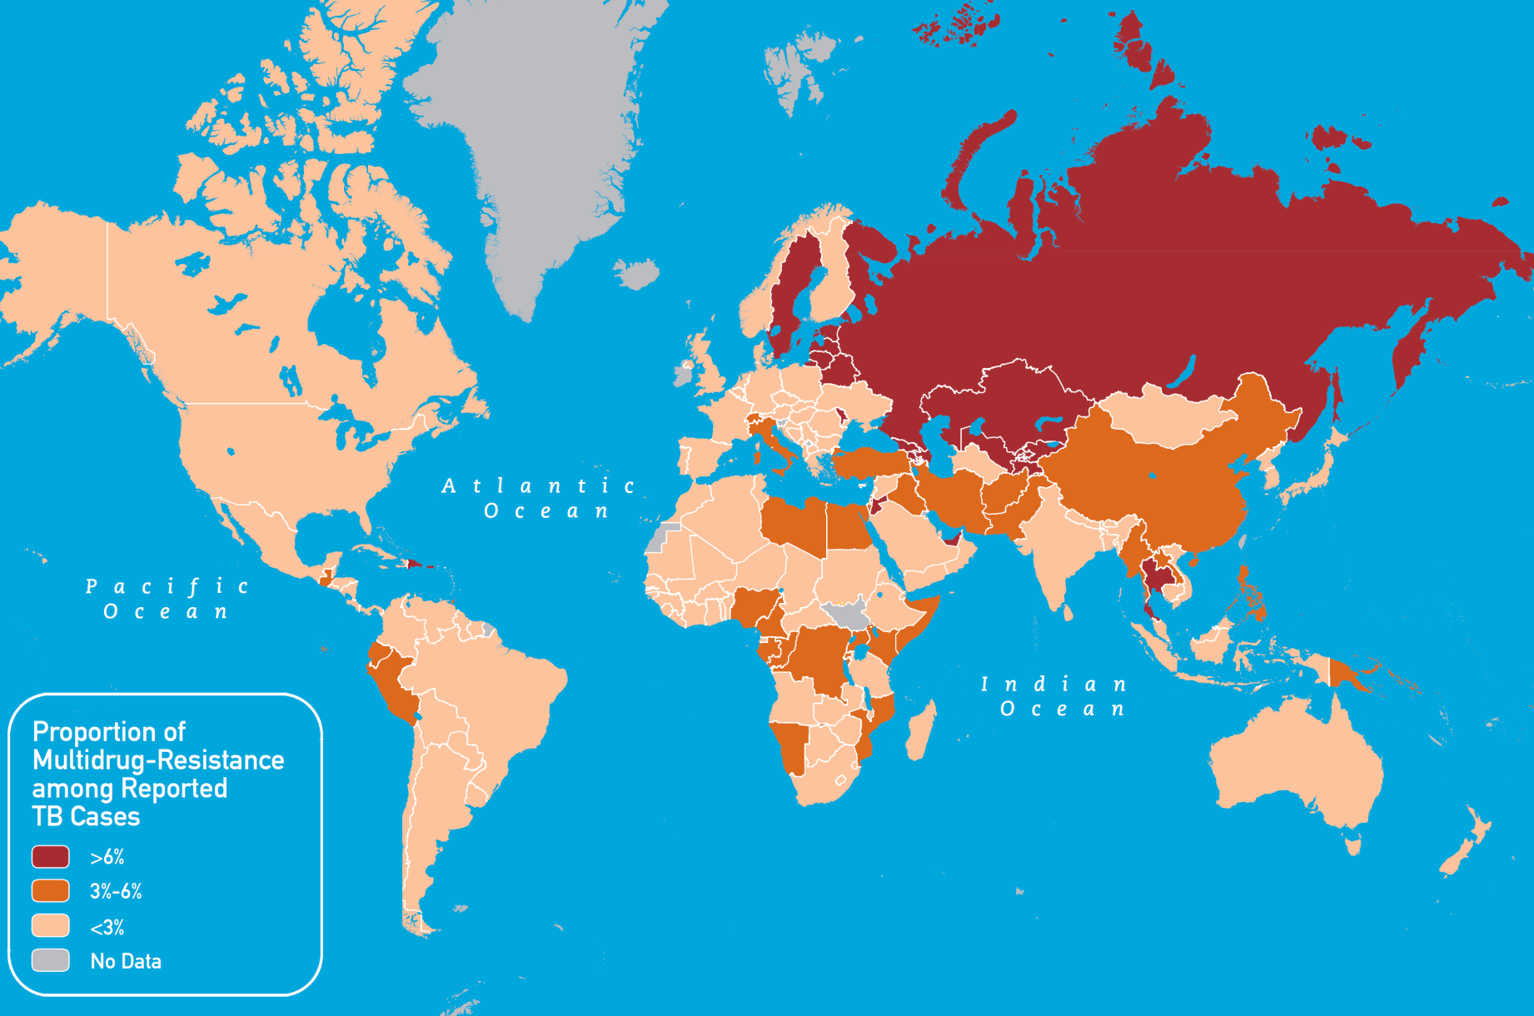
MDR-TB around the world
Available at: http://wwwnc.cdc.gov/travel/content/yellowbook/2014/map_3-14.pdf

Slide 16
MDR-TB around the world
Resistance rates in Canada 2012:
INH resistance: 8%
RMP resistance: 0.6%
EMB resistance: 0.3%
PZA resistance: 2.8%
Any resistance in 10% (90% mono-resistance)
MDR-TB 0.6% (Ontario: 1.8%)
XDR-TB 0.1%
Trends:
Available at: http://wwwnc.cdc.gov/travel/content/yellowbook/2014/map_3-14.pdf

Slide 17
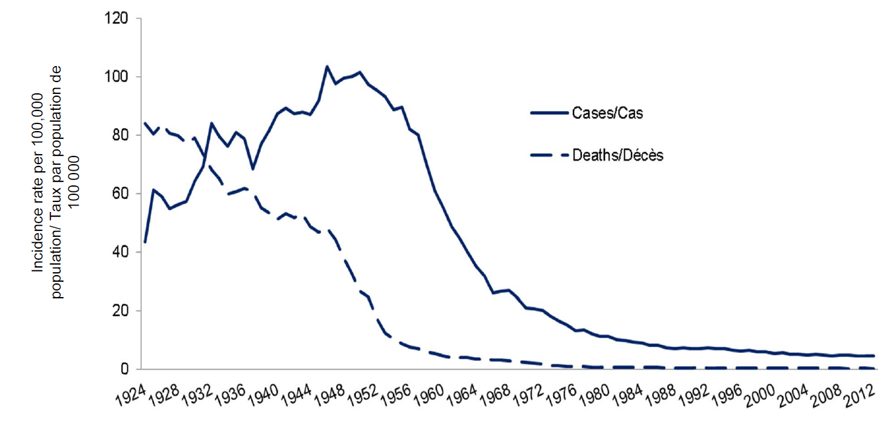
TB in Canada 1924-2012
From: Public Health Agency of Canada, Tuberculosis in Canada: 2002-2012

Slide 18
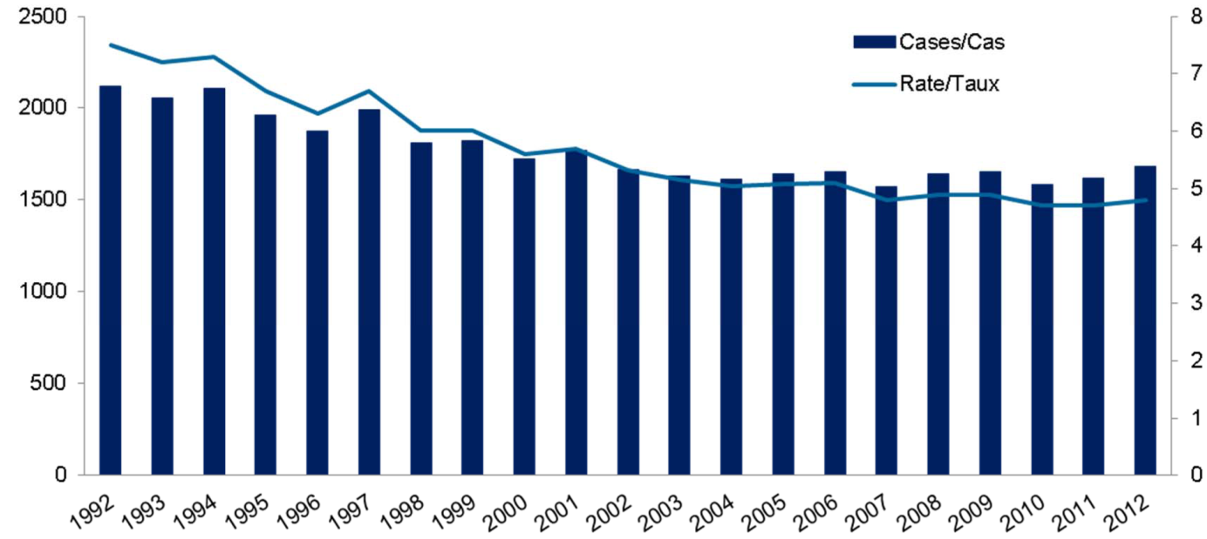
TB in Canada 1924-2012
From: Public Health Agency of Canada, Tuberculosis in Canada: 2002-2012

Slide 19
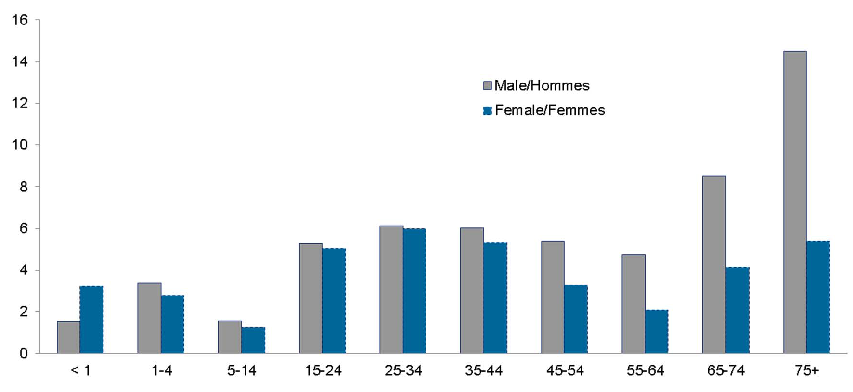
TB in Canada 2012, by age group
From: Public Health Agency of Canada, Tuberculosis in Canada: 2002-2012

Slide 20
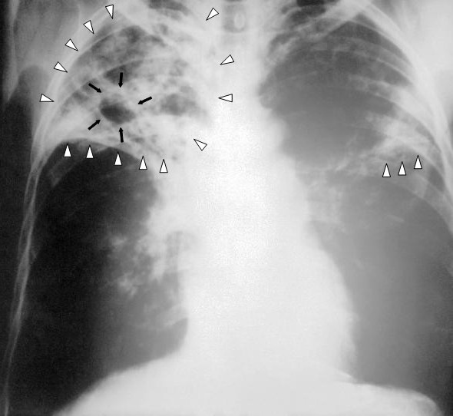
TB in Canada 2002-2012
75% pulmonary TB
(5% primo-infection)
13% CNS TB
10% Lymph node TB
From: Public Health Agency of Canada, Tuberculosis in Canada: 2002-2012

Slide 21
Canadian TB Standards 7th Edition
Previous versions in 1972, 1981, 1988, 1998, 2000, and 2007
Collaboration lead by the Canadian Thoracic Society (with Canadian Lung Association, Public Health Agency of Canada, Association of Medical Microbiology and Infectious Diseases)
Available at: http://www.respiratoryguidelines.ca/tb-standards-2013

Slide 22
Canadian TB Standards 7th Edition
√
●
●
x
x
x
x
●
●
x
x
●
x
x
●
x
Available at: http://www.respiratoryguidelines.ca/tb-standards-2013

Slide 23
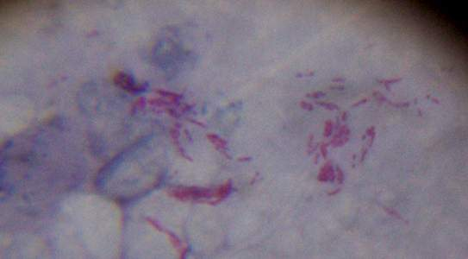
Pathogenesis and transmission
Reservoir: humans
Fomites: insignificant (not airborne, die quickly)
Inhalation of bacilli-containing droplets
Cell-mediated immunity is key
Once established (18 months), primary infection due to re-exposure 5x less likely

Slide 24
Pathogenesis and transmission
Transmission risk is associated with:
Bacterial burden (smear positivity, cavitary lesions, adult>>children)
Location (upper lung zones, laryngeal>pulmonary disease)
Amount and severity of cough
Duration of exposure
Proximity to source case
Crowding and room ventilation
Delays in diagnosis and effective treatment
Notes:
Smear positivity increases transmission risk 5-fold
Children typically with lower bacterial burden → up to 10 years of age generally not considered infectious

Slide 25
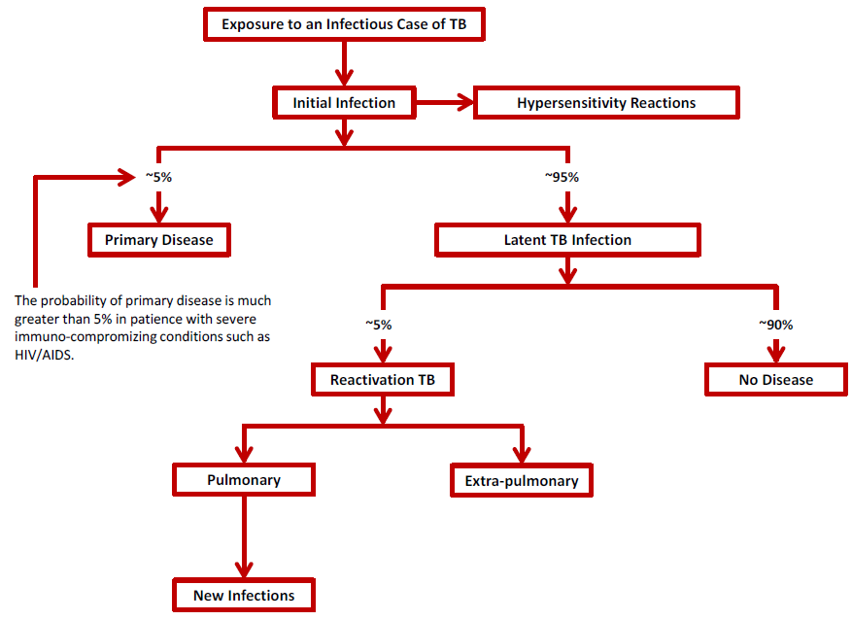
Pathogenesis and transmission
Available at: http://www.respiratoryguidelines.ca/tb-standards-2013

Slide 26
Pathogenesis and transmission
Typically 2-6 months post exposure.
At risk: infants, young children, immunocompromised
Available at: http://www.respiratoryguidelines.ca/tb-standards-2013

Slide 27
Pathogenesis and transmission
>18-24 months post exposure
Majority of cases in Canada
Available at: http://www.respiratoryguidelines.ca/tb-standards-2013

Slide 28
Canadian TB Standards 7th Edition
√
√
●
x
x
x
x
●
●
x
x
●
x
x
●
x
Available at: http://www.respiratoryguidelines.ca/tb-standards-2013

Slide 29
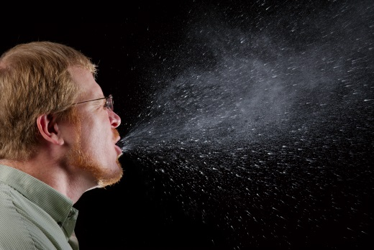
Diagnosis of active TB
Indication for testing: signs and symptoms consistent with TB and at high risk of TB disease
>2-3 weeks of cough
Initially non-productive, later-on productive
Fever, night sweats, hemoptysis, anorexia, weight loss, chest pain…
Sensitivity and specificity insufficient
Notes:
Symptoms: >2-3 weeks of cough
DST: drug susceptibilty testing
TST: tuberculin skin test
IGRA: interferon gamma release assay
NAAT: nucleic acid amplification test (not confirmatory)
Chest x-ray: sensitivity 70-80%, specificity 60-70%, poor inter-rater variability

Slide 30
Diagnosis of active TB
Indication for testing: signs and symptoms consistent with TB and at high risk of TB disease
Microbiological testing:
Smear microscopy and culture+DST
3 sputum samples, >1 hour apart (sensitivity similar to three morning sputum, approximately 70%)
Induced sputum with sensitivity of 75%
Bronchoscopy similar yield as sputum samples (sensitivity 77%)
Alternative: Gastric acid aspirate (sensitivity approx. 50%)
Culture: 2-8 weeks, >90% sensitivity with 3 samples (vs. 6 samples)
Notes:
Symptoms: >2-3 weeks of cough
DST: drug susceptibilty testing
TST: tuberculin skin test
IGRA: interferon gamma release assay
NAAT: nucleic acid amplification test (not confirmatory)
Chest x-ray: sensitivity 70-80%, specificity 60-70%, poor inter-rater variability

Slide 31
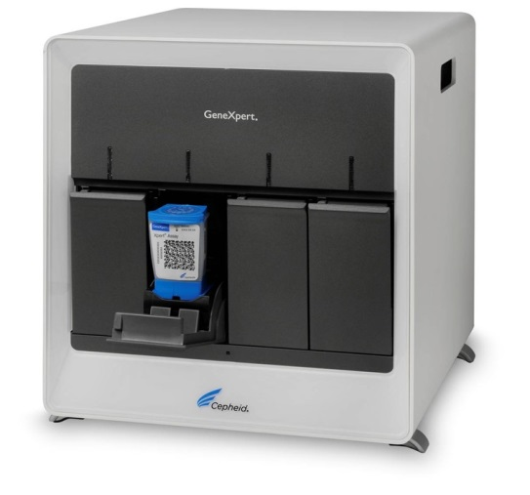
Diagnosis of active TB
Indication for testing: signs and symptoms consistent with TB and at high risk of TB disease
Microbiological testing:
Smear microscopy and culture+DST
NAAT for M. tuberculosis complex
Sensitivity >95% in smear positive and 50-70% in smear negative TB
Increases yield of smears by 25%
E.g. GeneXpert → detects MTB and RMP resistance within 2 hours
Test 1 smear positive sample, smear negative on request
Need confirmation by smear and culture+DST
Notes:
Symptoms: >2-3 weeks of cough
DST: drug susceptibilty testing
TST: tuberculin skin test
IGRA: interferon gamma release assay
NAAT: nucleic acid amplification test (not confirmatory)
Chest x-ray: sensitivity 70-80%, specificity 60-70%, poor inter-rater variability; up to 90% sensitivity with all listed findings

Slide 32
Diagnosis of active TB
Indication for testing: signs and symptoms consistent with TB and at high risk of TB disease
Microbiological testing:
Smear microscopy and culture+DST
NAAT for M. tuberculosis complex
Supported by: Chest x-ray
upper lobe, volume loss, cavitation
sensitivity 70-80%, specificity 60-70%
Notes:
Symptoms: >2-3 weeks of cough
DST: drug susceptibilty testing
TST: tuberculin skin test
IGRA: interferon gamma release assay
NAAT: nucleic acid amplification test (not confirmatory)
Chest x-ray: sensitivity 70-80%, specificity 60-70%, poor inter-rater variability; up to 90% sensitivity with all listed findings

Slide 33
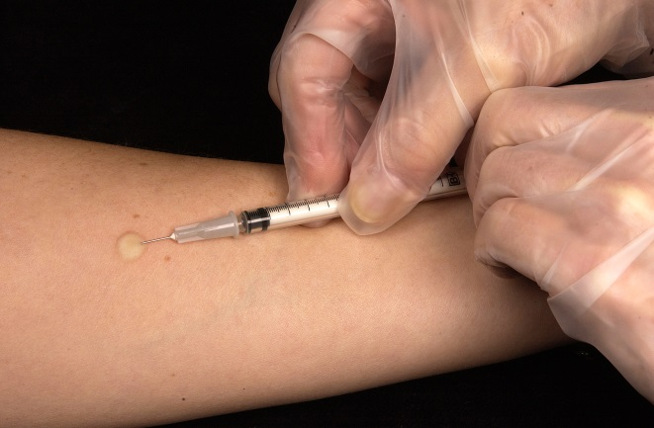
Diagnosis of active TB
Indication for testing: signs and symptoms consistent with TB and at high risk of TB disease
Microbiological testing:
Smear microscopy and culture+DST
NAAT for M. tuberculosis complex
Supported by: Chest x-ray
NOT recommended: TST and IGRA
Cannot discriminate between latent and active TB
Insufficient sensitivity, in particular with HIV co-infection
Recommended as an adjunct for diagnosis in children
Notes:
Symptoms: >2-3 weeks of cough
DST: drug susceptibilty testing
TST: tuberculin skin test
IGRA: interferon gamma release assay
NAAT: nucleic acid amplification test (not confirmatory)

Slide 34
Canadian TB Standards 7th Edition
√
√
√
x
x
x
x
●
●
x
x
●
x
x
●
x
Available at: http://www.respiratoryguidelines.ca/tb-standards-2013

Slide 35
Drug resistant TB
Risk factors in Canada:
previous TB treatment
born in a country where drug-resistant TB is prevalent
exposed to drug-resistant TB
All cultures to undergo DST
INH, RMP, PZA, EMB
second-line DST for RMP-resistant strains
Treatment of latent TB based on DST in source patient

Slide 36
Canadian TB Standards 7th Edition
√
√
√
x
x
x
x
√
●
x
x
●
x
x
●
x
Available at: http://www.respiratoryguidelines.ca/tb-standards-2013

Slide 37
Paediatric TB
Canadian-born Aboriginal and foreign-born children
Source case identification if <5 y/o
Gastric aspirates and induced sputum
High risk of progression
Low culture yield:
TB diagnosed on positive TST/IGRA, chest x-ray, history of contact, signs and symptoms

Slide 38
Canadian TB Standards 7th Edition
√
√
√
x
x
x
x
√
√
x
x
●
x
x
●
x
Available at: http://www.respiratoryguidelines.ca/tb-standards-2013

Slide 39
Contact Follow-Up
Goal is to minimize the risk of transmission. Priorities:
Early identification and treatment of active TB cases
Identify secondary cases (& source case), and those recently acquired latent TB (on average 4-6 close contacts, of these typically 1-2% have active TB and 5% will develop active TB <2 years)
Offer treatment to source case and preventive treatment for latent TB in TST positive contacts

Slide 40
Contact Follow-Up
How long back to consider someone infectious? Expert opinions:
Smear positive ~3 months before onset of respiratory symptoms/diagnosis
Asymptomatic cases with no cavities: 1 month

Slide 41
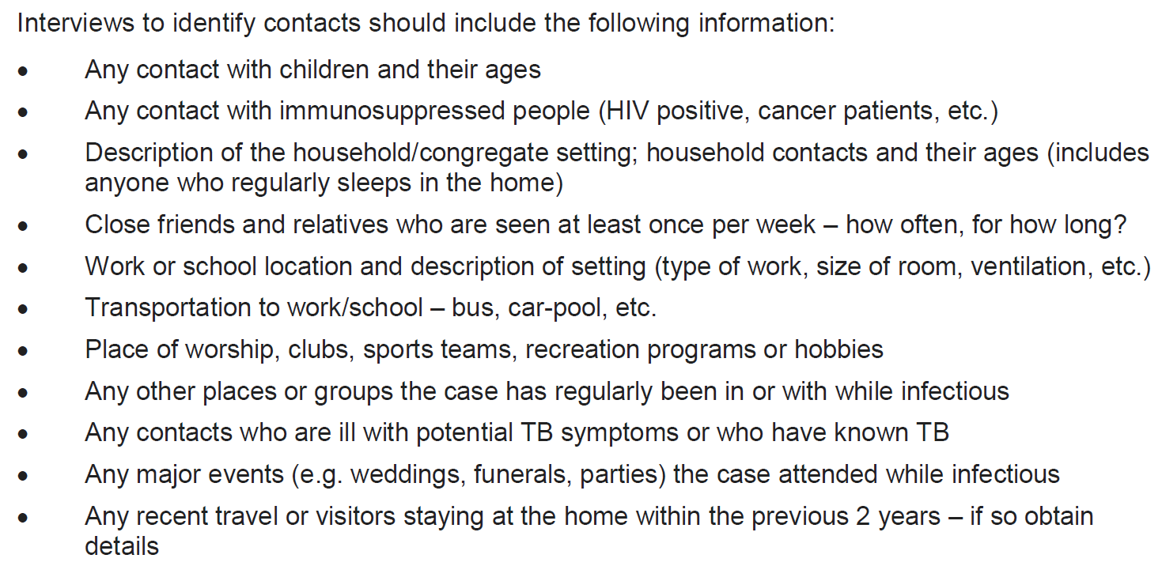
Contact Follow-Up
Available at: http://www.respiratoryguidelines.ca/tb-standards-2013

Slide 42
Contact Follow-Up
For smear positive and negative cases
Priority on contacts at high risk of being infected or at risk of developing active TB: (no longer classic concentric approach)
High: household contacts + immunologically vulnerable non-household contacts (e.g. children <5 y/o)
Medium: close non-household contacts with +/- daily exposure
Low: casual contacts

Slide 43
Contact Follow-Up
Household contacts:
Sleeping regularly in the same household, including room-mates, boarders, “couch-surfers”…
For smear positive and negative cases
Priority on contacts at high risk of being infected or at risk of developing active TB:
(no longer classic concentric approach)
High: household contacts + immunologically vulnerable non-household contacts (e.g. children <5 y/o)
Medium: close non-household contacts with +/- daily exposure
Low: casual contacts
Non-household contacts:
Classroom contacts, co-wokers, regular sexual partners, close friends
Casual contacts:
Classmates with only few shared courses, team or group members, school bus contacts
Notes:
Houshold contact: sleeping regularly in the same household (3-4x / week minimum)
Italic: New in 7th edition → not a concentric approach anyomore.

Slide 44
Contact Follow-Up
More shared airspace (risk incereases by approx. 1% per hour)
Household contacts:
Sleeping regularly in the same household, including room-mates, boarders, “couch-surfers”…
For smear positive and negative cases
Priority on contacts at high risk of being infected or at risk of developing active TB:
(no longer classic concentric approach)
High: household contacts + immunologically vulnerable non-household contacts (e.g. children <5 y/o)
Medium: close non-household contacts with +/- daily exposure
Low: casual contacts
Non-household contacts:
Classroom contacts, co-wokers, regular sexual partners, close friends
Casual contacts:
Classmates with only few shared courses, team or group members, school bus contacts
Notes:
Houshold contact: sleeping regularly in the same household (3-4x / week minimum)
Italic: New in 7th edition → not a concentric approach anyomore.

Slide 45
Contact Follow-Up
For smear positive and negative cases
Priority on contacts at high risk of being infected or at risk of developing active TB:
(no longer classic concentric approach)
High: household contacts + immunologically vulnerable non-household contacts (e.g. children <5 y/o)
Medium: close non-household contacts with +/- daily exposure
Low: casual contacts
Problem:
The amount of exposure constituting significant risk is unknown and there is no 0% risk exposure

Slide 46
Contact Follow-Up
For smear positive and negative cases
Priority on contacts at high risk of being infected or at risk of developing active TB:
(no longer classic concentric approach)
High: household contacts + immunologically vulnerable non-household contacts (e.g. children <5 y/o)
Medium: close non-household contacts with +/- daily exposure
Low: casual contacts
Smear-negative, non-cavitary pulmonary TB
Smear-positive/cavitary/laryngeal TB

Slide 47
Contact Follow-Up
Expand to next group if transmission considered:
TST converters
Rate of TST >10mm higher than expected for a certain group (e.g. unvaccinated HCW 5-18%)
<5 y/o infected without obvious source

Slide 48
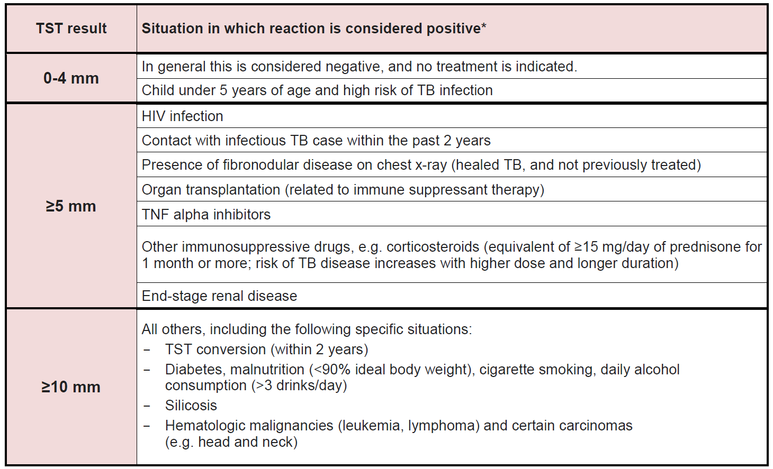
Contact Follow-Up
Expand to next group if transmission considered:
TST converters
Rate of TST >10mm higher than expected for a certain group (e.g. unvaccinated HCW 5-18%)
<5 y/o infected without obvious source
Available at: http://www.respiratoryguidelines.ca/tb-standards-2013
Notes:
Conversion can occur as early as 3 weeks after exposure

Slide 49
Canadian TB Standards 7th Edition
√
√
√
x
x
x
x
√
√
x
x
√
x
x
●
x
Available at: http://www.respiratoryguidelines.ca/tb-standards-2013

Slide 50
TB in the Health Care setting
Latent TB rates in HCW increase with:
Number of years working in a health care setting where TB patients are cared for, ED or medical wards, and HIV infected patients
Number of annual TB cases in a specific setting
High-risk activities like cough-producing procedures, bronchoscopy, intubation, autopsy, microbiology lab procedures
Effective IPAC program can reduce risk of TB transmissions

Slide 51
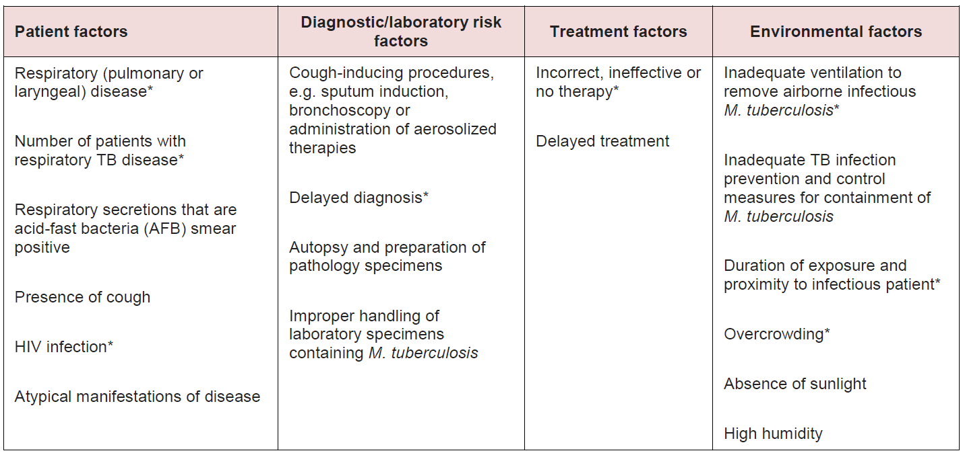
Risk factors in Health Care setting
Available at: http://www.respiratoryguidelines.ca/tb-standards-2013

Slide 52
The bad and the ugly…
Delayed diagnosis in 50% of respiratory TB cases
24 HCW on average exposed per case
Early detection, airborne precautions, and treatment is key to prevent transmission
Note: <5 y/o consider source in family
Rao et al. Ann Intern Med 1999; 130: 404-411

Slide 53
Suggested case definition
Available at: http://www.respiratoryguidelines.ca/tb-standards-2013

Slide 54
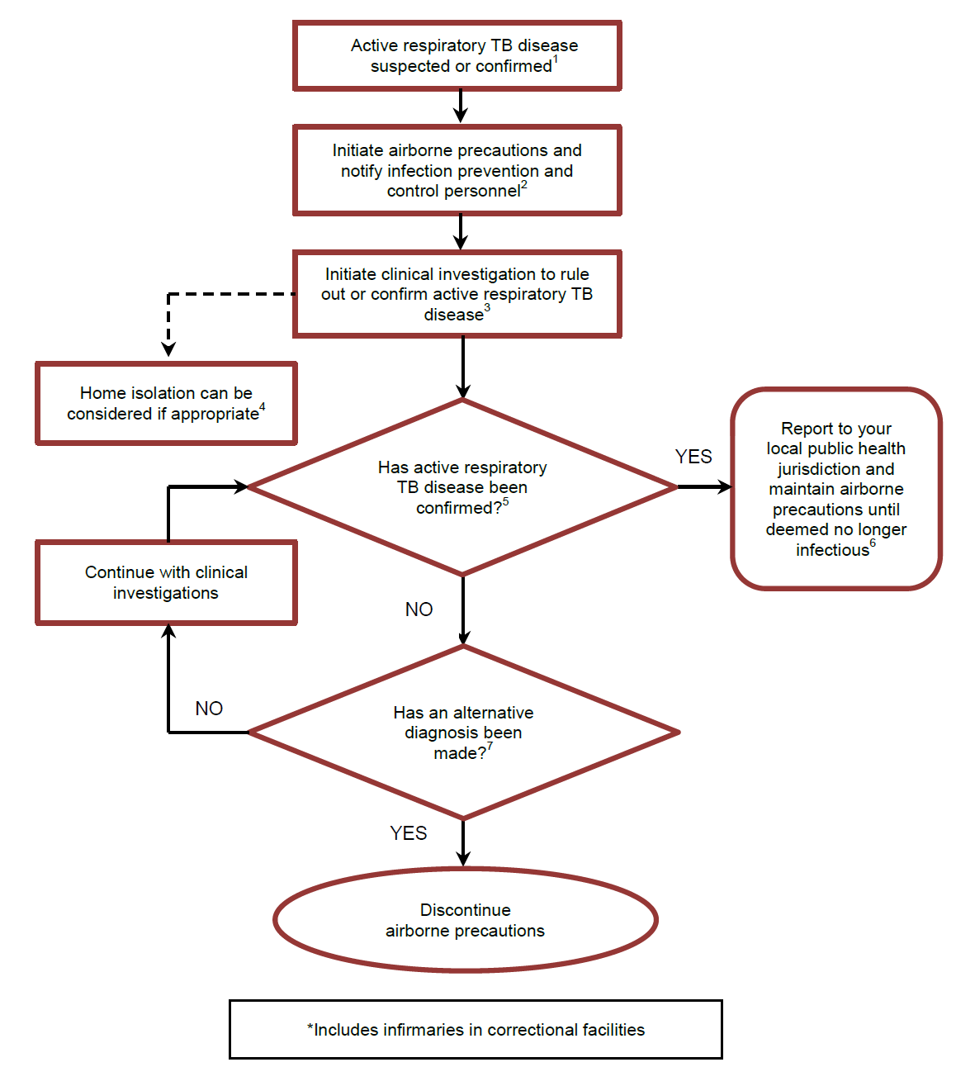
Steps for Isolation
Available at: http://www.respiratoryguidelines.ca/tb-standards-2013

Slide 55
Steps for Isolation
Available at: http://www.respiratoryguidelines.ca/tb-standards-2013

Slide 56
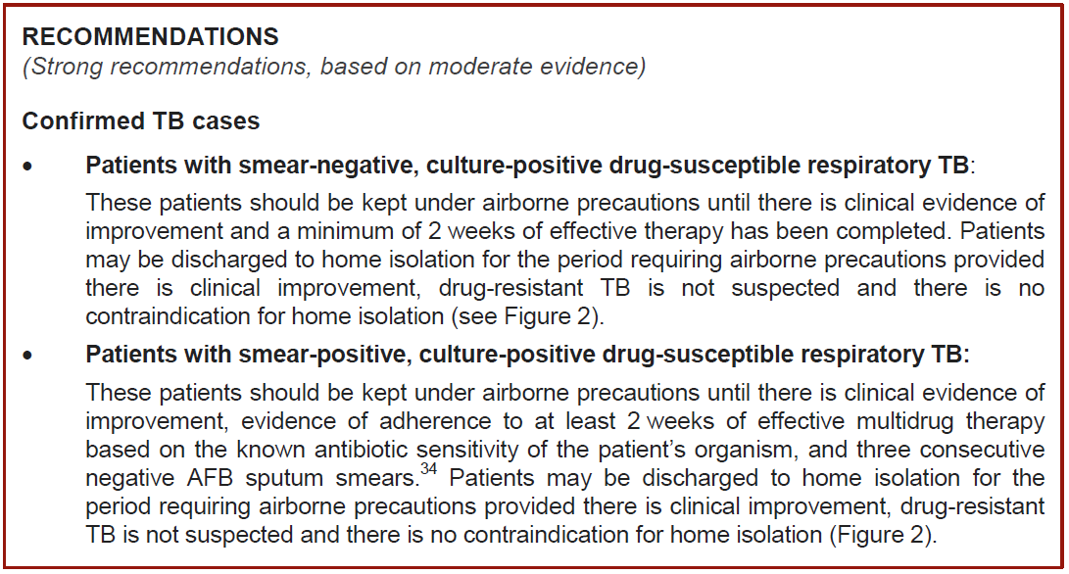
Discontinuation of AIIR
Available at: http://www.respiratoryguidelines.ca/tb-standards-2013
Notes:
Resistance to RMP or MDR Tb: AIIR until 3 sputa are culture negative after 6 weeks of incubation

Slide 57
Discontinuation of AIIR
No recommendation on whether or not NAAT should be considered in ruling out TB
→ 3 smears theoretically less sensitive than 1-2 negative smears PLUS negative NAAT
Available at: http://www.respiratoryguidelines.ca/tb-standards-2013
Notes:
Resistance to RMP or MDR Tb: AIIR until 3 sputa are culture negative after 6 weeks of incubation

Slide 58
Conditions for home isolation
Available at: http://www.respiratoryguidelines.ca/tb-standards-2013
Notes:
Resistance to RMP or MDR Tb: AIIR until 3 sputa are culture negative after 6 weeks of incubation

Slide 59
Conditions for home isolation
Homeless shelters and drop-in centers:
Patients cannot be isolated
For primary prevention of TB shelters should improve ventilation (open windows), UVGI
Available at: http://www.respiratoryguidelines.ca/tb-standards-2013
Notes:
Resistance to RMP or MDR Tb: AIIR until 3 sputa are culture negative after 6 weeks of incubation

Slide 60
Environmental Controls
Airborne infection isolation rooms (AIIR):
Negative pressure, exhausted outdoors or through HEPA filter
Doors and windows closed at all times
Increase from 1 to 6 air changes per hour (ACH) improves clearance 5-6x, but little (from 7-12x) to minimal (>12x) additional benefit with higher rates
at least 6 for existing and 9 for new AIIRs
(recommendations vary, CSA + CDC suggest 12)
Beggs et al. BMC Infect Dis 2012; 1-0:247
Notes:
Paucity of evidence re: number of ACHs
CSA: Candian Standards Associations

Slide 61
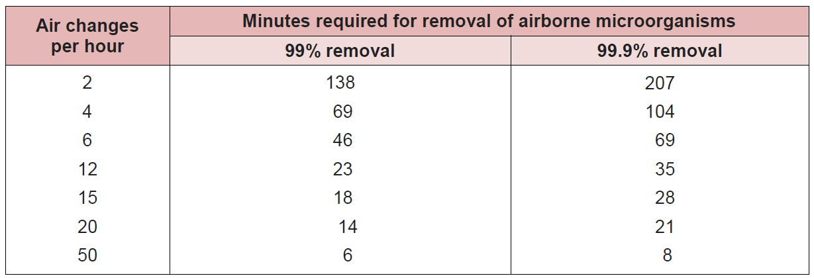
Environmental Controls
When to re-enter the room without PPE?
Available at: http://www.respiratoryguidelines.ca/tb-standards-2013
Notes:
At HHS?

Slide 62
Environmental Controls
What if AIIRs are not available?
Acceptable alternatives include:
Ultra-violet Germicidal Irradiation (UVGI), equivalent to 20 ACH
Portable High-efficiency Particulate Air (HEPA) Filtration units can replace higher ACH rates by cleaning circulating air
Notes:
UVGI: concerns include skin cancer and eye damage

Slide 63
Personal Protection Controls
N95 respirators
must be available for all staff for all contacts with suspected TB cases
Minimal effect in AIIR environment
fit-testing endorsed (jurisdictional requirement), but not supported by evidence
Masks
For patients when leaving AIIR/transfer
Fennelly et al. ICHE 2009; 19: 754-9
Notes:
Paucity of evidence re: number of ACHs
CSA: Candian Standards Associations

Slide 64
Post-exposure follow-up
TST negative HCW at baseline:
One single TST 8 weeks post exposure
TST positive HCW at baseline:
TST of limited value, IGRA can be considered but is not recommended
Early assessment for signs/symptoms of active TB is key
Notes:
Unclear cut-offs for IGRA

Slide 65
Long-term care facility
Same recommendation for N95 and masks, respectively, as in acute care setting
TST not generally recommended >65y/o (neither baseline nor post exposure)
Low sensitivity
Harm may outweigh benefit for treatment of latent TB
Screening to focus on active TB (posterior-anterior and lateral chest x-ray upon admission)
Notes:
Unclear cut-offs for IGRA

Slide 66
TB Prevention: specific situations
Intubation: bacterial filter on endotracheal tube to prevent contamination of the ventilator
Surgery:
Postponed when possible
Exhaust to the outside
Postoperative recovery in OR or AIIR
Ambulatory care:
Postponed when possible
schedule at the end of the day
Mask at arrival for patient until in AIIR or closed single room
Notes:
Unclear cut-offs for IGRA

Slide 67
Major Changes in 7th Edition
Active TB: Three specimens on same day and incorporation of NAAT
Contact f/u: Change from classic concentric circle model to prioritization based on infectiousness of source and susceptibility of exposed contacts
Notes:
Unclear cut-offs for IGRA

Slide 68
Take home messages
Approximately 1800 TB cases/year in Canada
High risk groups include immigrants and Aboriginal Canadians
Control of TB in health care setting is based on a strong IPAC/TB control program, environmental control, and PPE
Main challenge remains unspecific signs and symptoms with delay in diagnoses…
Notes:
Unclear cut-offs for IGRA

Slide 69
Notes:
69

